Slide 1
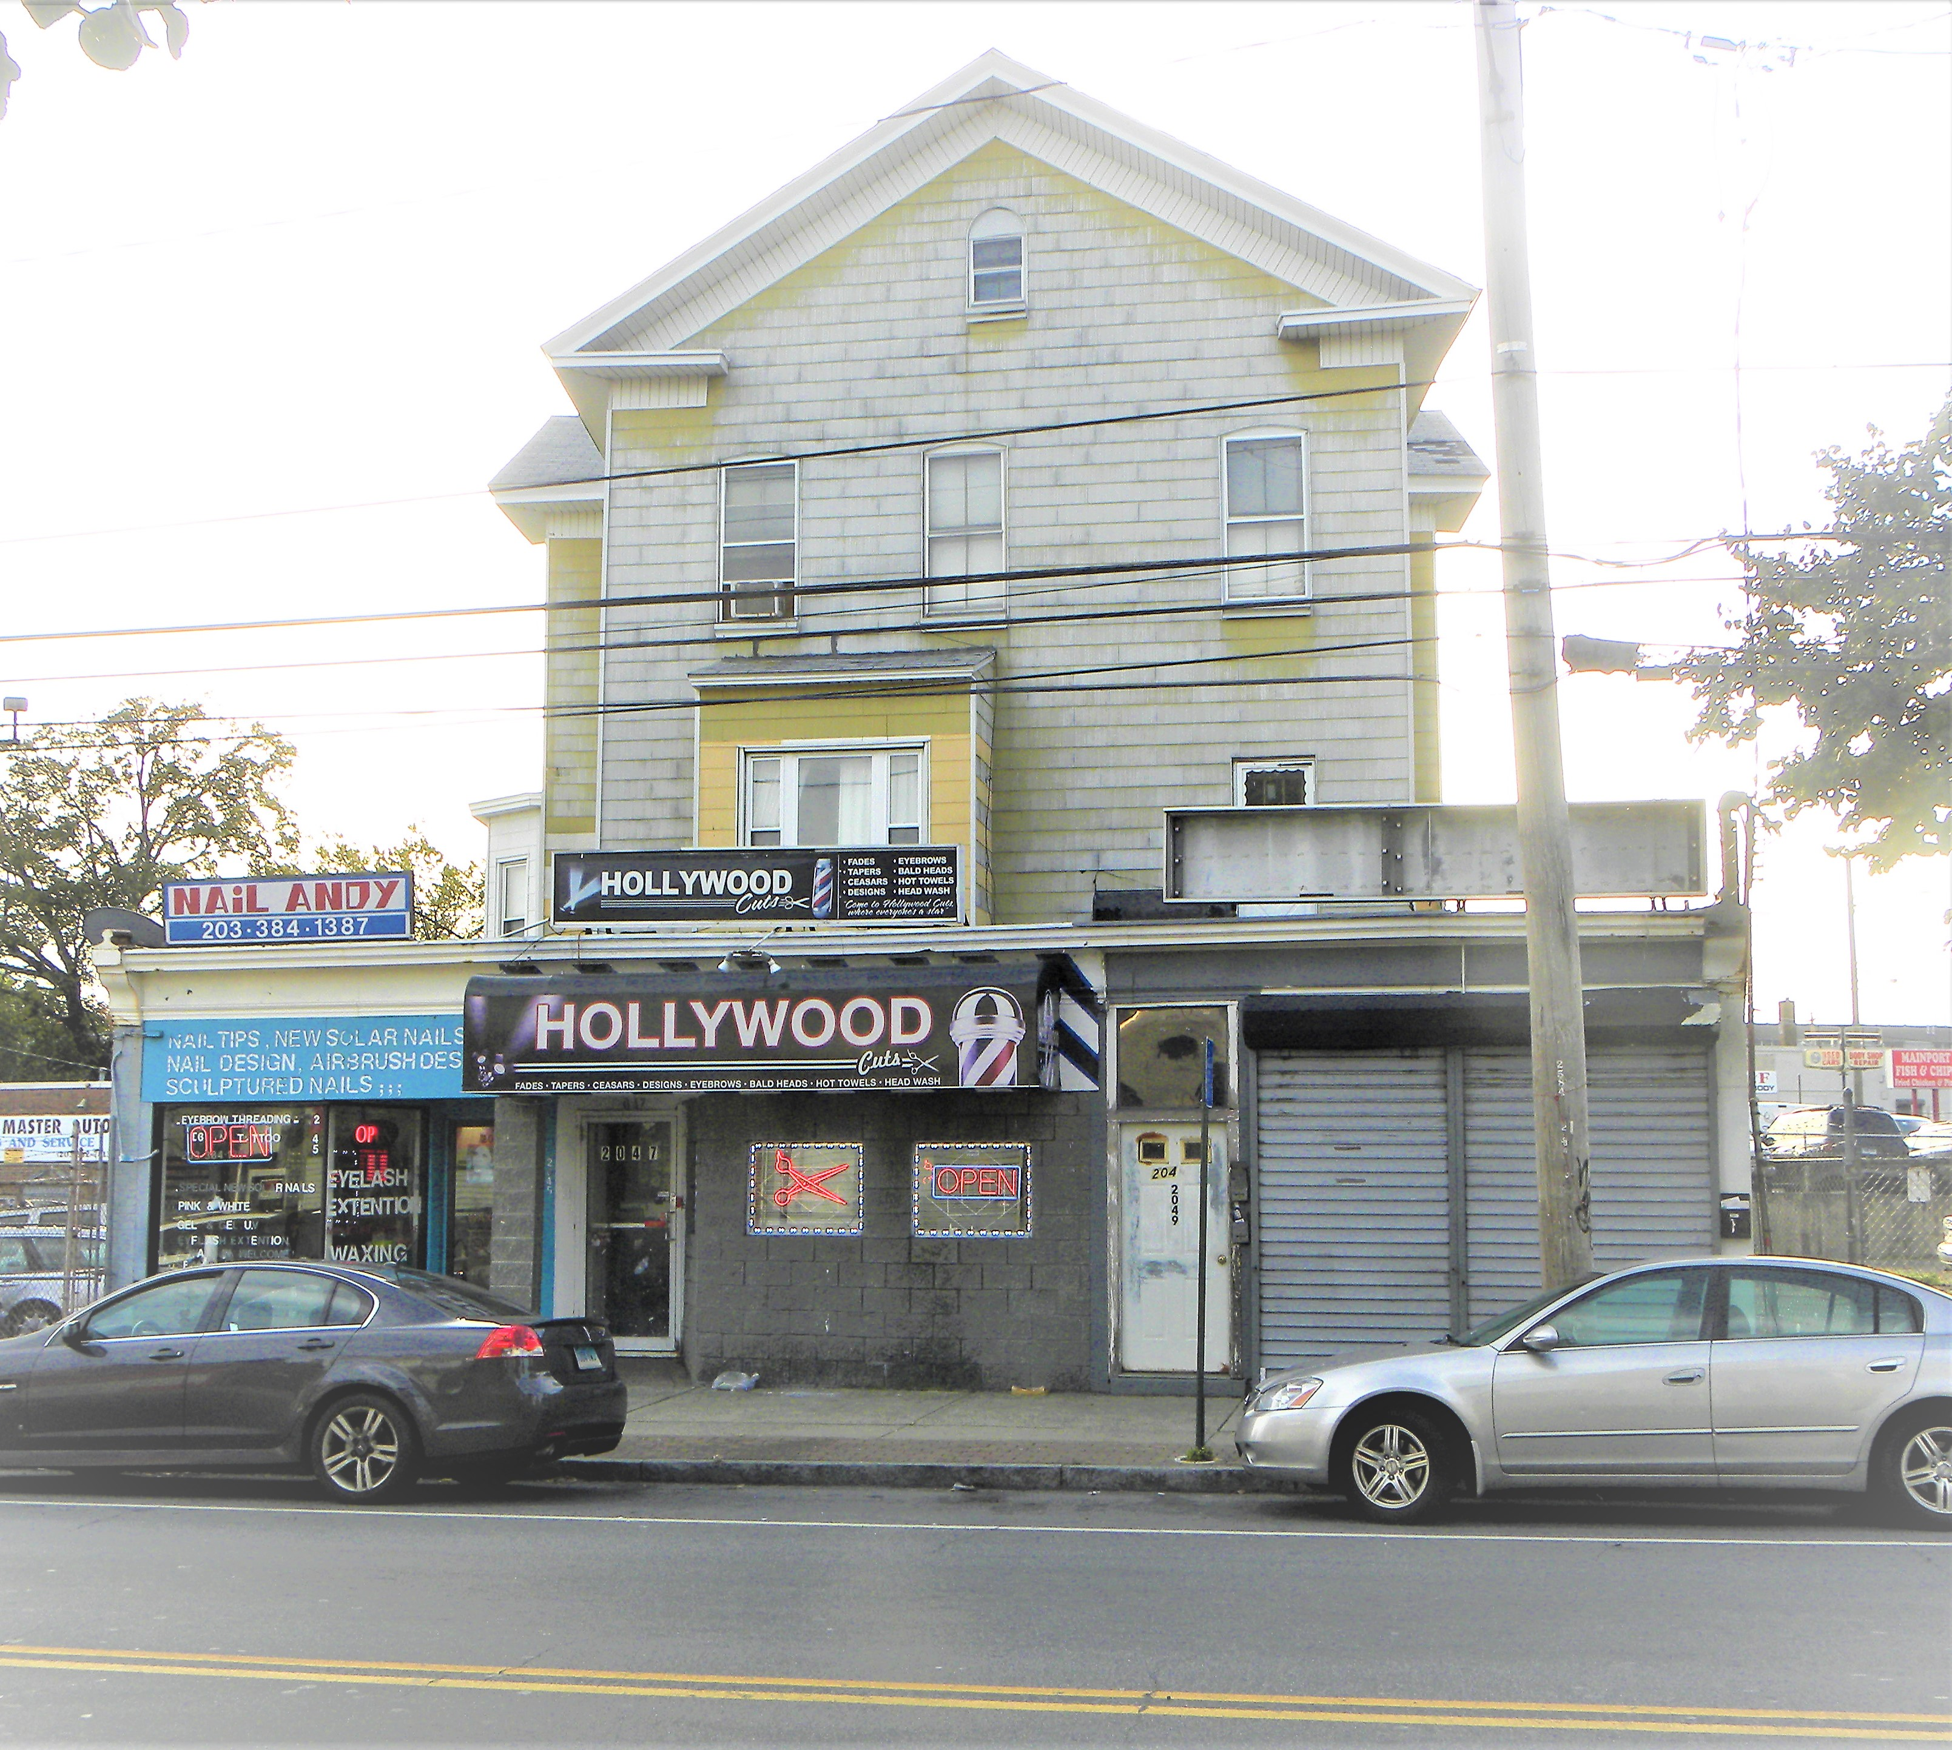
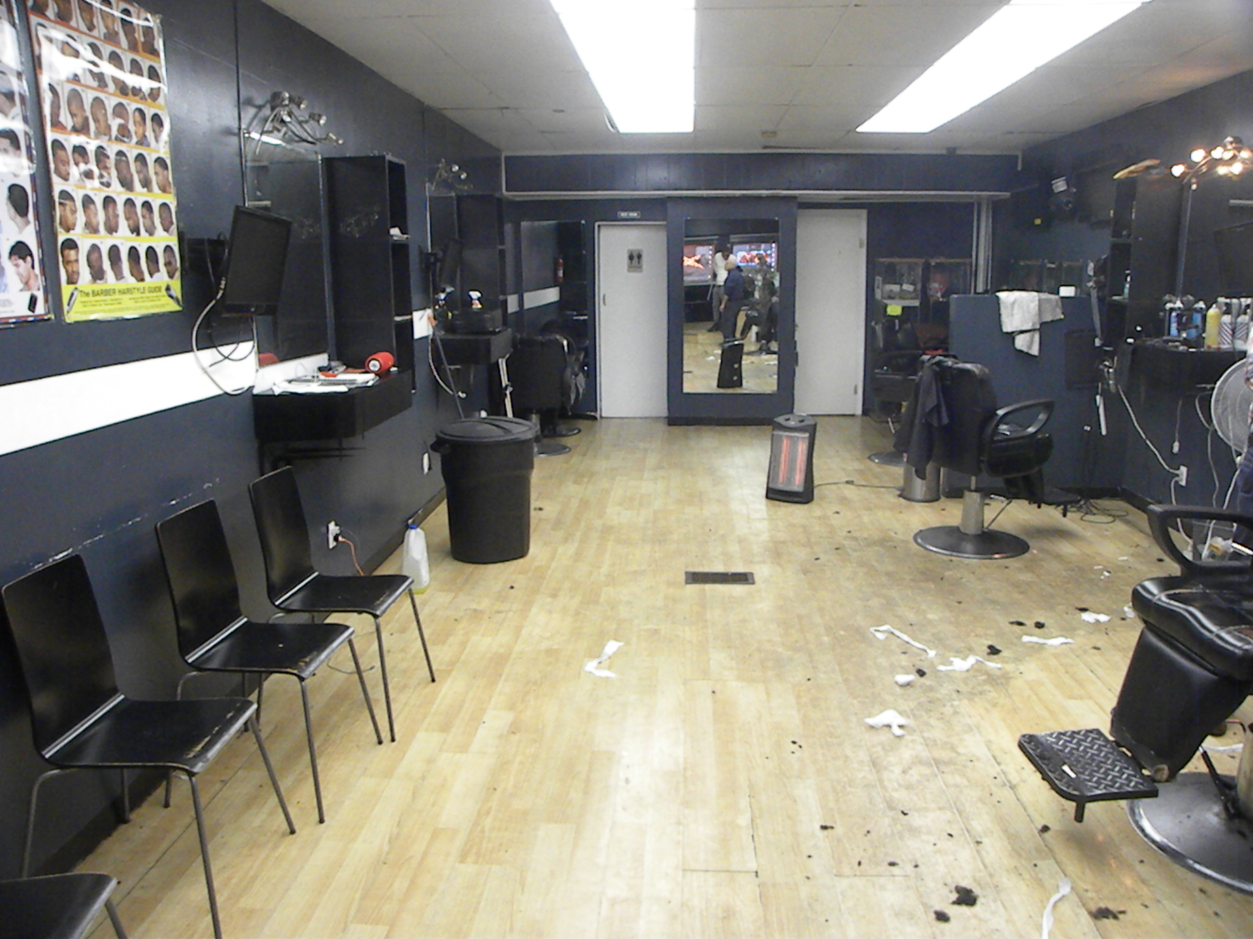
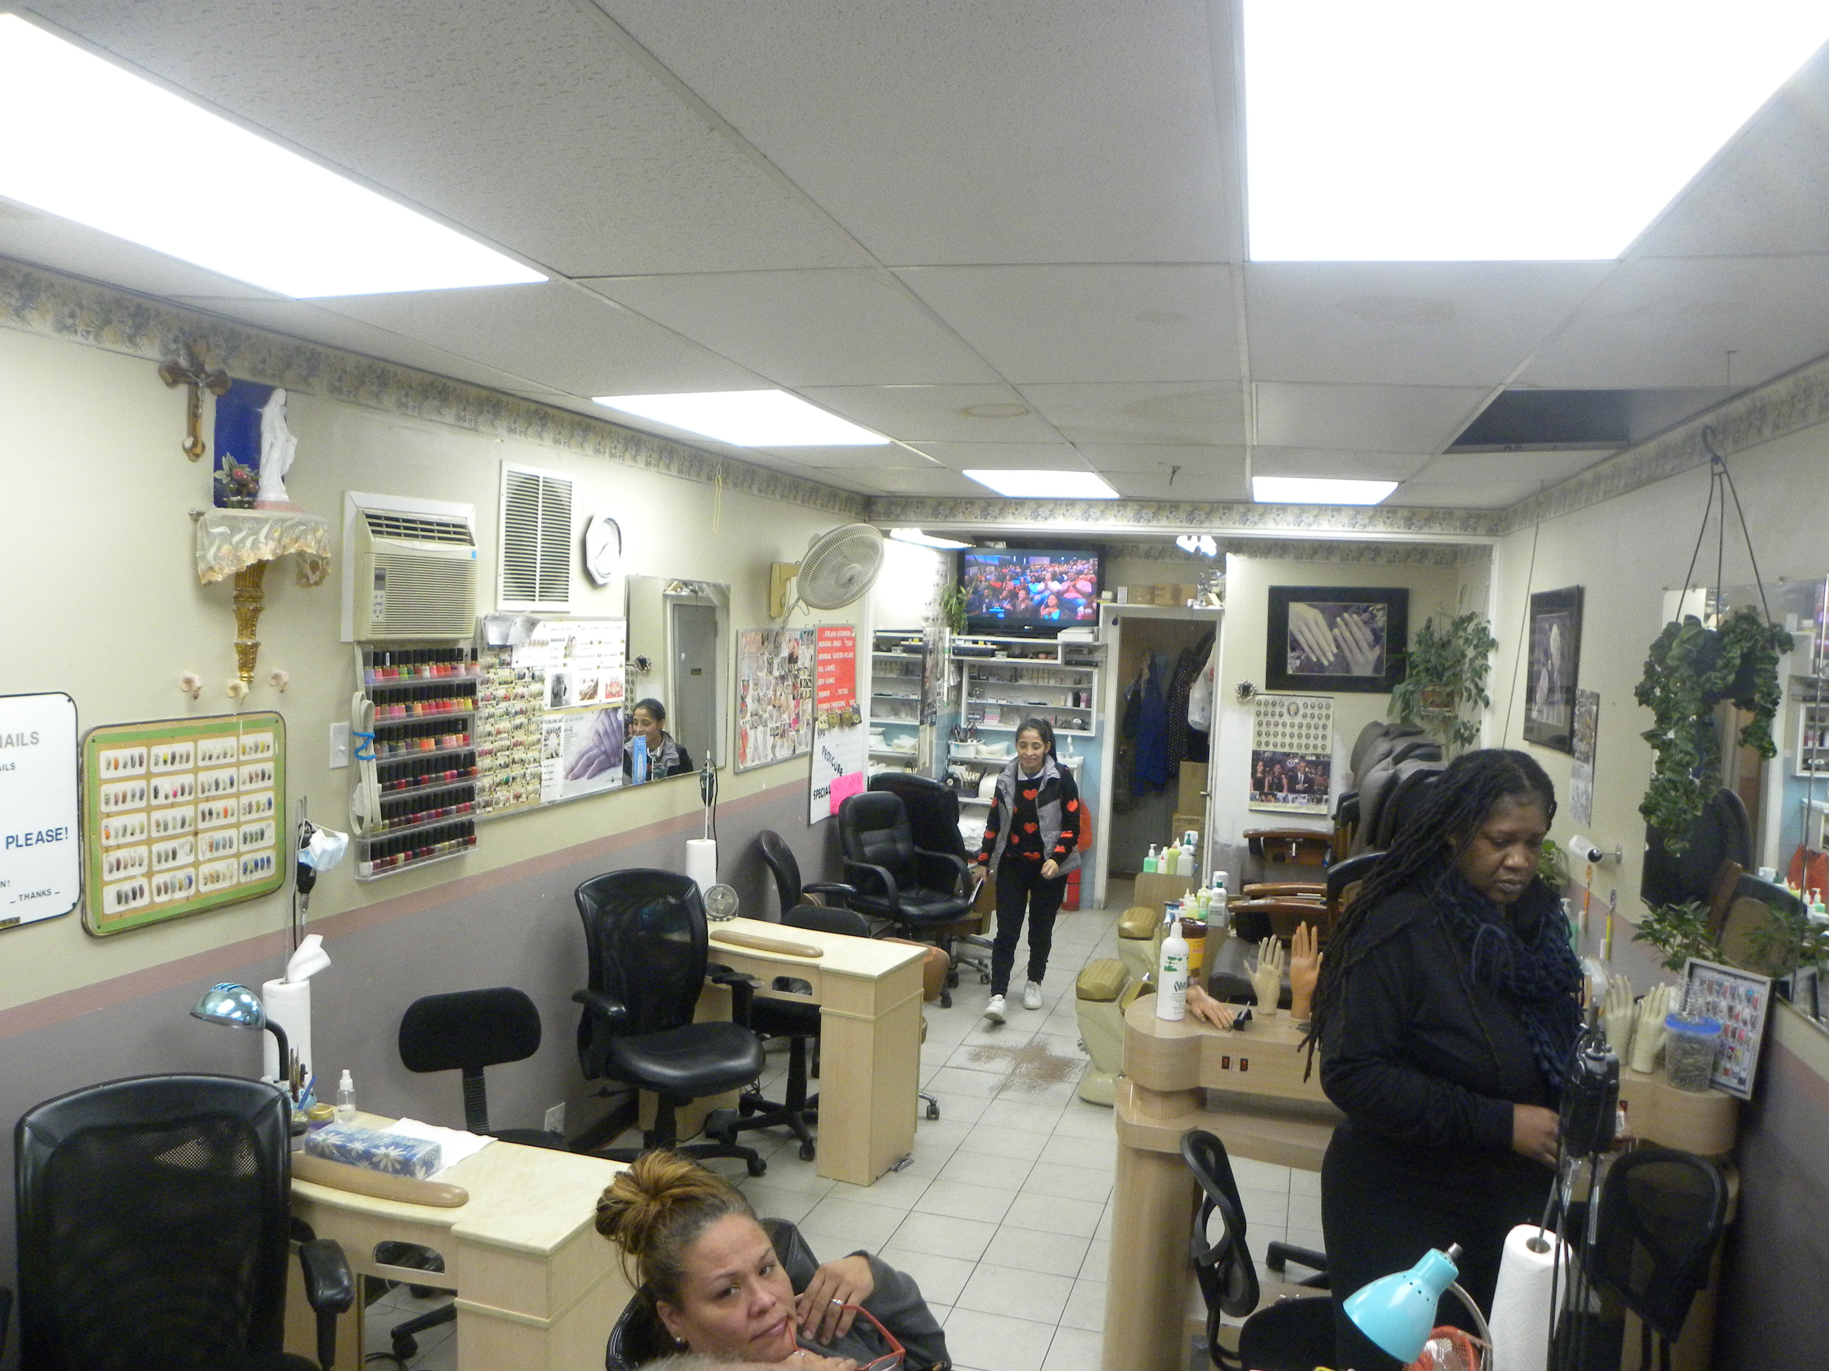
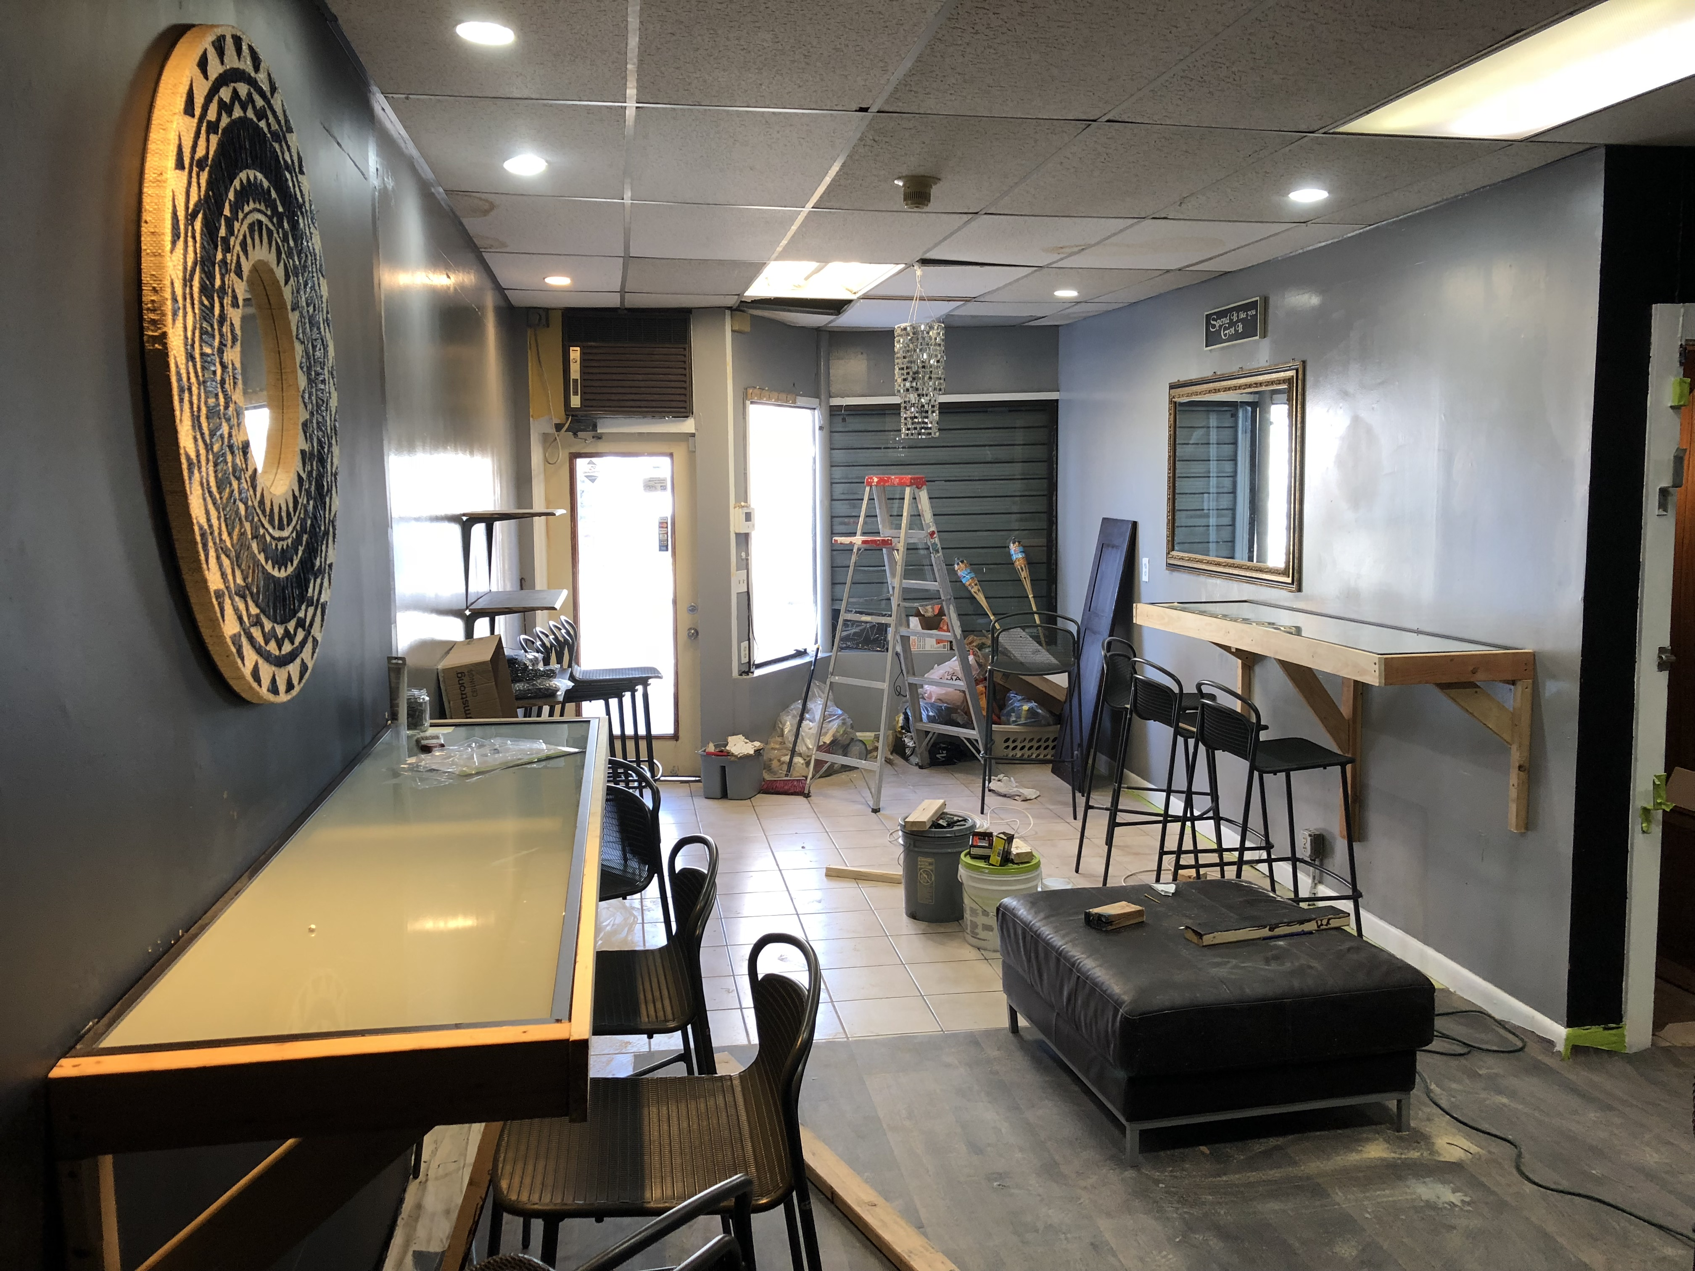
(2049 Main Street)
(Bridgeport, CT 06896)
$ 350,000
http://www.awardpropct.com
Investment property will excellent potential. This mixed use retail/residential property is fully leased on a month-to-month basis that are under market value. The building consists of 3 retails storefronts and 2 full sized apartments. The current rate of return is 8.5% cap rate without debt services and with under market rents. This property can be an easy 11.5-12%+ cap with market rates and some upgrades. Please contact the listing broker for rent rolls or more information.
(Alexander Ward)
(Principal Broker)
Phone: (203)-470-6275
Email: awardpropertiesct@yahoo.com
DCP Lic. REB: 0790021
Fairfield, CT 06825
Building size:
Lot size:
Heat:
Ceiling height:
Age:
Traffic Count:
Taxes:
5,203 Sq Ft
.12 Acres
Natural Gas
10+/-
1920
13,600 on main and 13,800 on North St (2007-2014 Study)
$11,464

