Slide 1
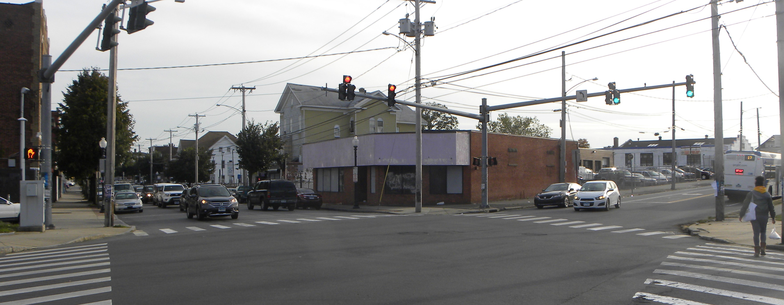
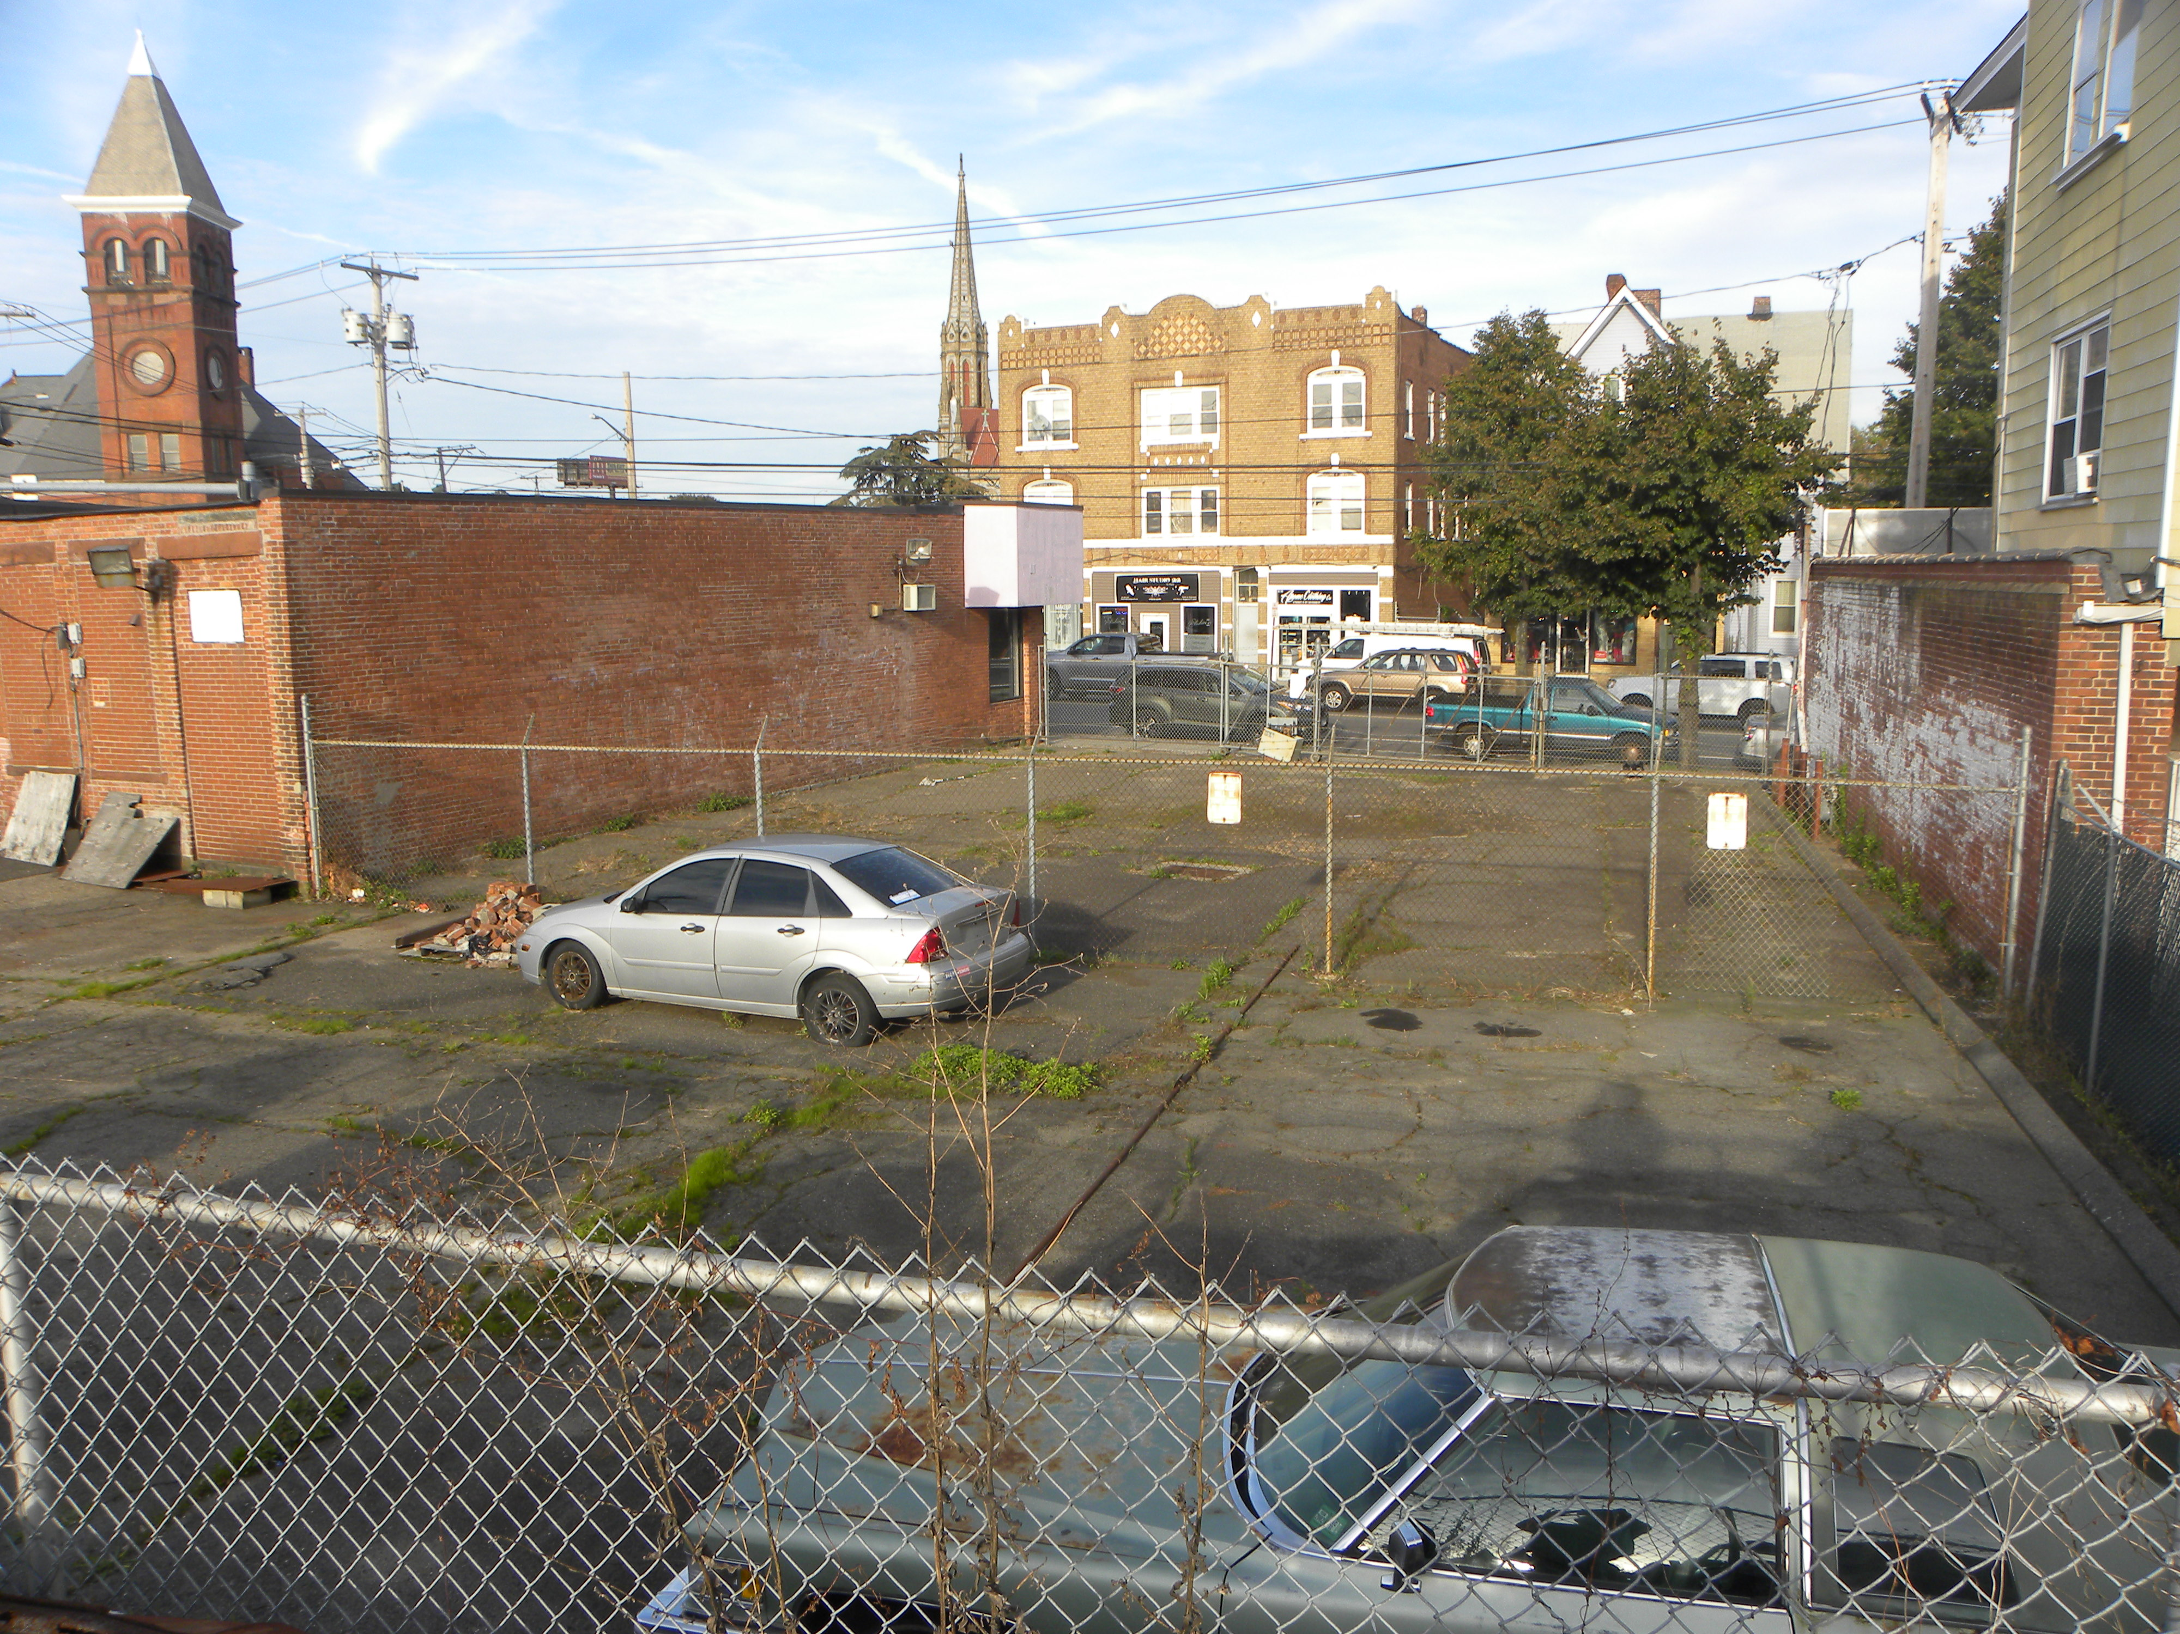
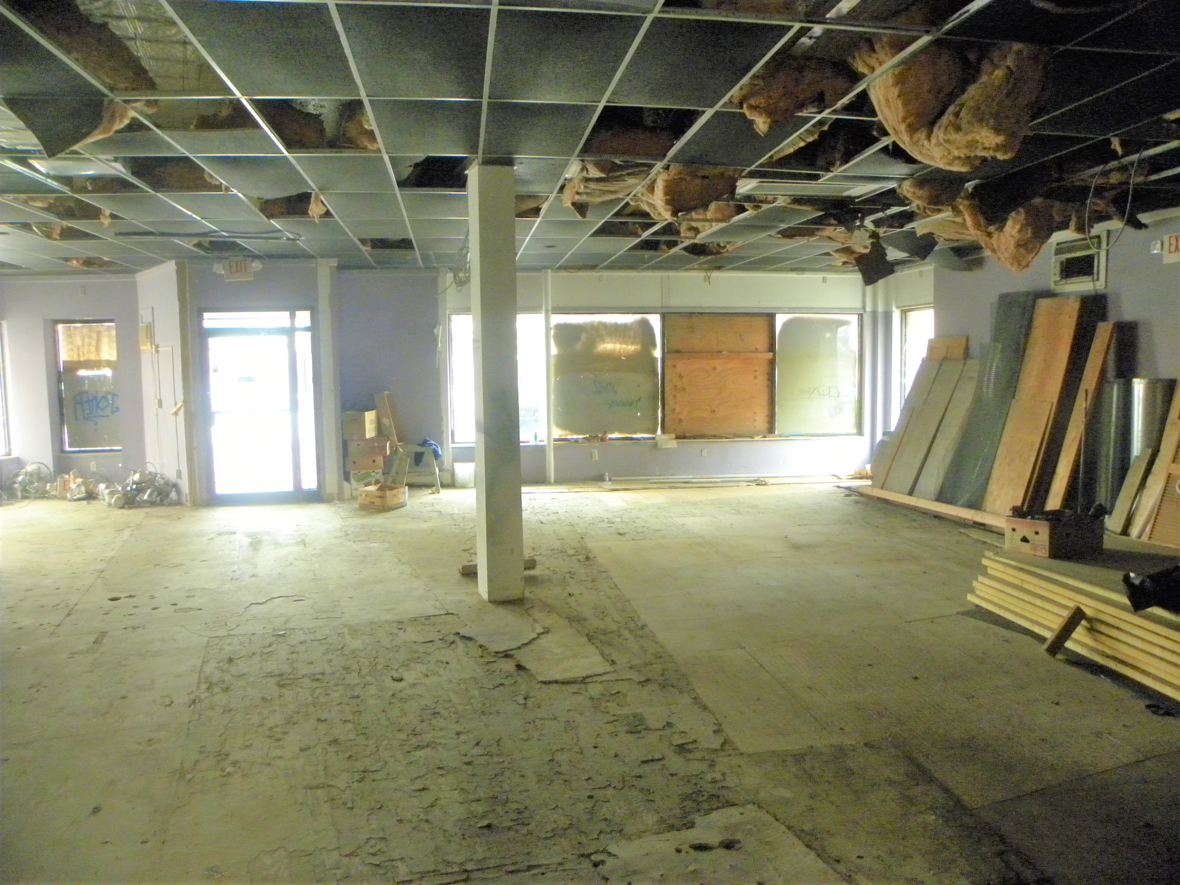
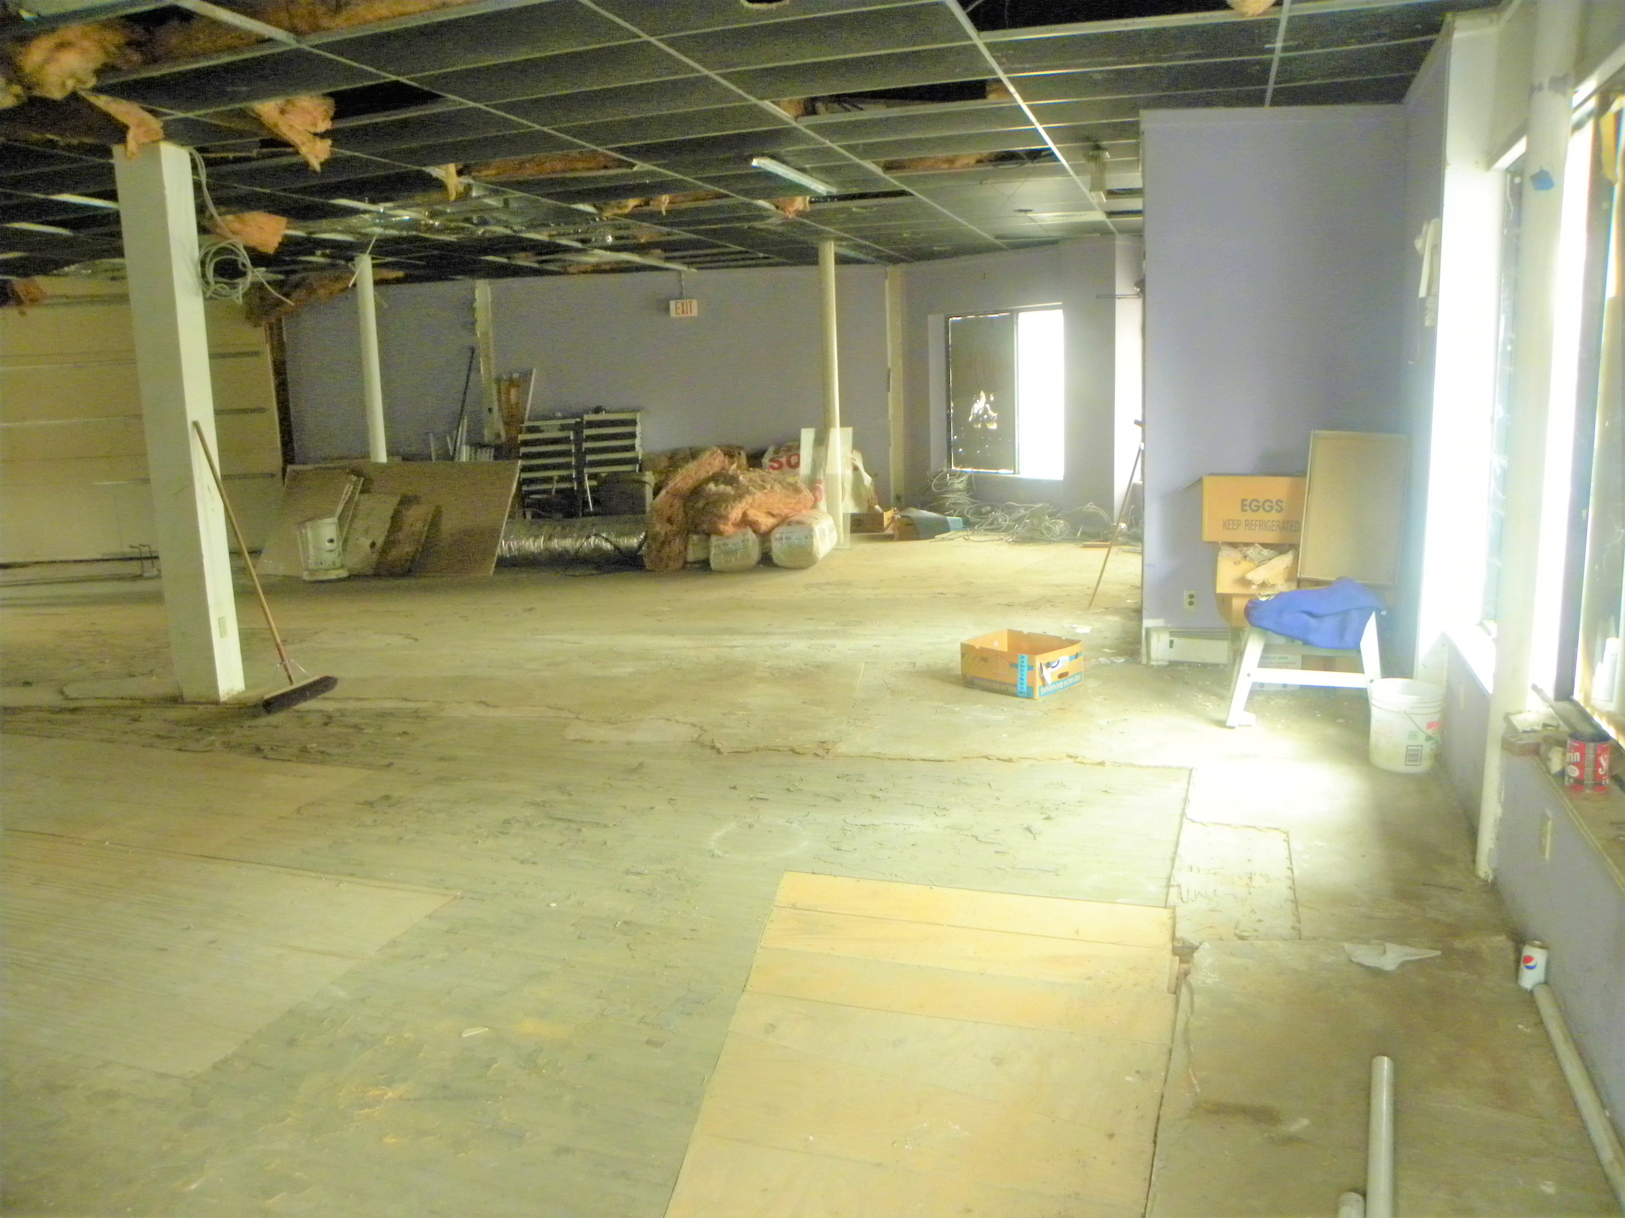
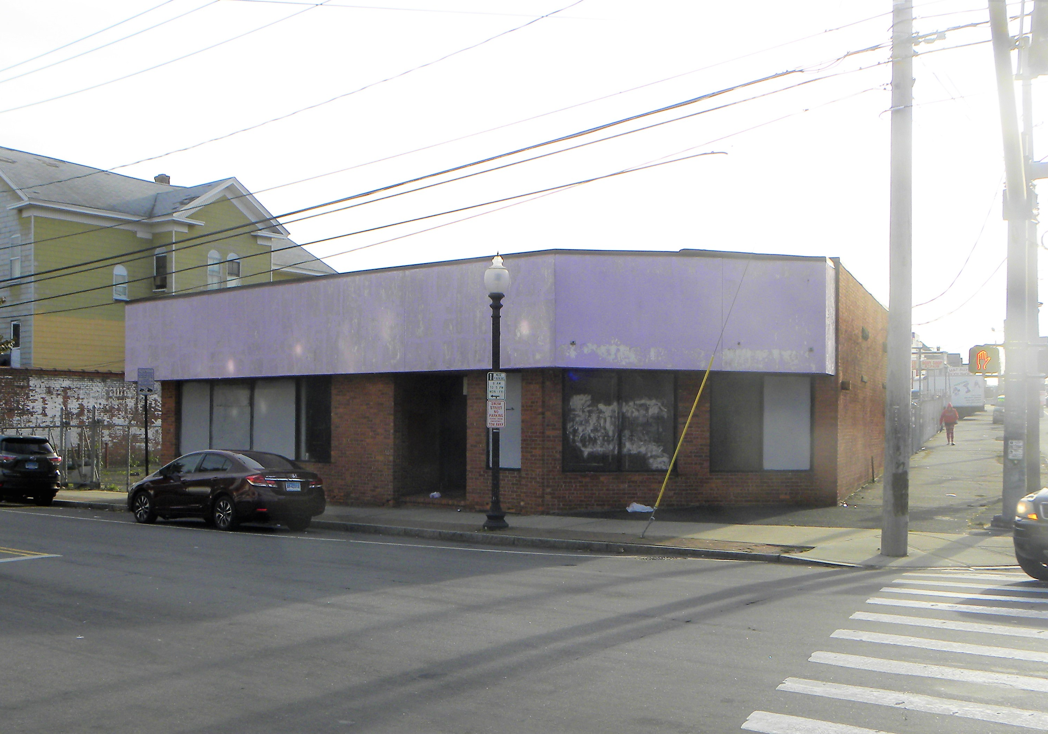
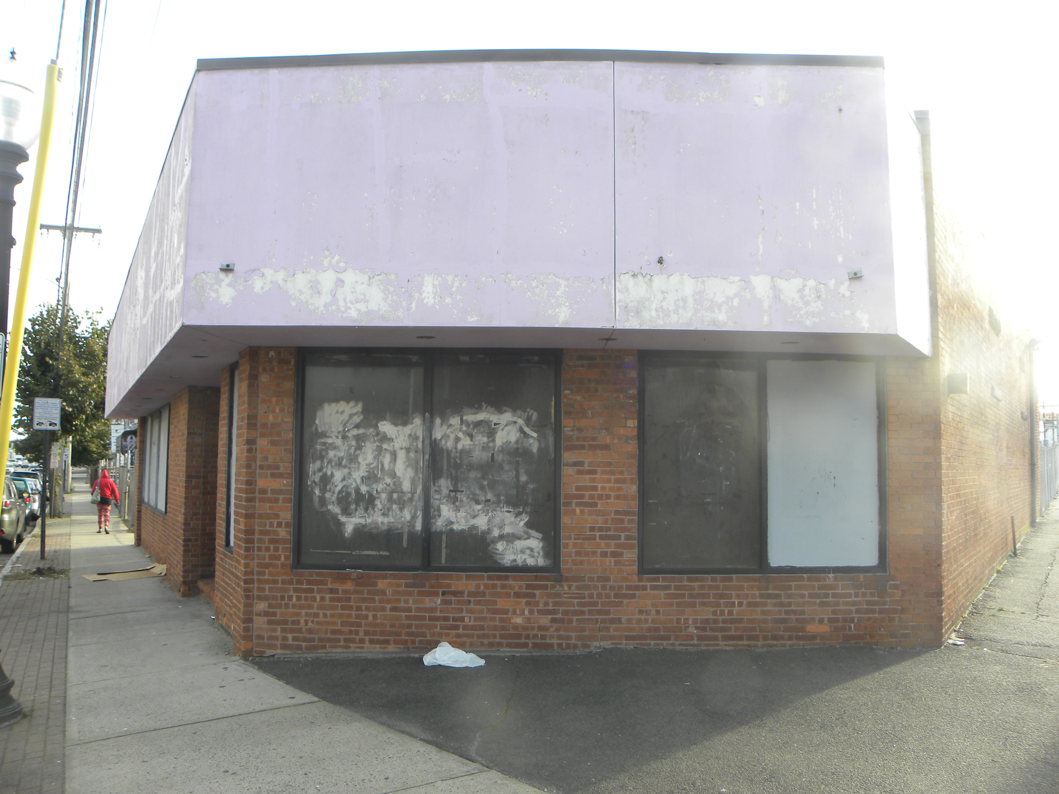
(2065-2067 Main Street)
(Bridgeport, CT 06896)
$ 650,000
http://www.awardpropct.com
Rare opportunity to buy or lease a corner lot with drive thru potential on the junction of two heavily traveled roads. This property offers two entrance points to the street, one on Main st and the other on North St. Newer rubber roof on the structure with solid structure. Full basement spanning almost the entire length of the building.
(Alexander Ward)
(Principal Broker)
Phone: (203)-470-6275
Email: awardpropertiesct@yahoo.com
DCP Lic. REB: 0790021
Fairfield, CT 06825
Building size:
Lot size:
Heat:
Ceiling height:
Age:
Traffic Count:
2,832 Sq Ft (5,664 Sq Ft Gross)
.22 Acres
Natural Gas
14+/-
1920
13,600 on main and 13,800 on North St (2007-2014 Study)

